Slide 1
Business Sentiment Analysis Project
Presented By :
Apoorv Mishra
Aryan
Sohit Sachdev
Snigdha Taneja

Slide 2
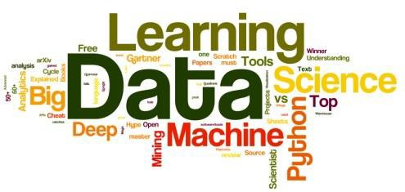
Presentation Outline:
Introduction
Problem Statement
Exploring the dataset
Methodology
Expectation from the models.

Slide 3
Introduction
SENTIMENT ANALYSIS is the most common text classification tool that analyses an incoming message and tells whether the underlying sentiment is positive, negative our neutral. It's a form of text analytics that uses natural language processing (NLP) and machine learning algorithms. Sentiment analysis is also known as “opinion mining” or “emotion artificial intelligence”. Sentiment analysis helps data analysts within large enterprises gauge public opinion, conduct nuanced market research, monitor brand and product reputation, and understand customer experiences. It finds its uses in sectors such as e-commerce, marketing, advertising, politics, stock market research.

Slide 4

Problem Statement
In this project, our aim is to implement a Business Sentiment Analysis Model that helps to overcome the challenges of identifying the sentiments of the clients towards a certain business policy.

Slide 5

Exploring the Datasets

Slide 6
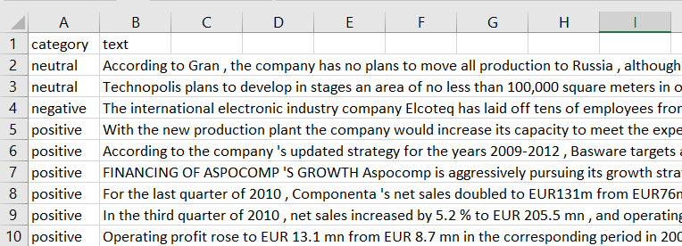
Secondary Dataset : This dataset (FinancialPhraseBank) is obtained from Kaggle and contains the sentiments from the perspective of a retail investor.
The dataset contains two columns, “Category" and “Text". The sentiment can be categorized as negative, neutral or positive.
Source: Malo, P., Sinha, A., Takala, P., Korhonen, P. and Wallenius, J. (2014): “Good debt or bad debt: Detecting semantic orientations in economic texts.” Journal of the American Society for Information Science and Technology.

Slide 7
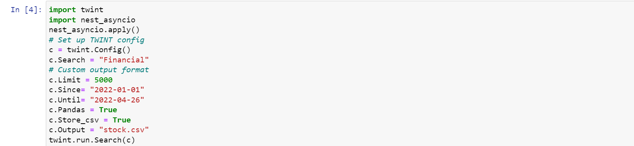
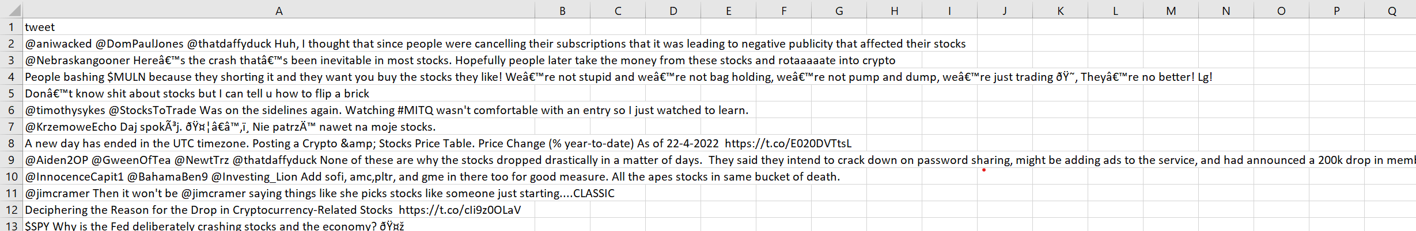
Scraped Dataset : This dataset is extracted from Twitter’s search operator i.e. the tweets relating to Financial Sentiments of users towards business policies and stocks, the library used in Jupyter Notebook to obtain the data is “TWINT”.
Twint is an open-source python library that is used for twitter scraping i.e we used twint to scrape data from twitter and that too without using the twitter API.
The raw dataset hence obtained contain 11560 tweets.

Slide 8

METHODOLOGY

Slide 9
Approach
Data Preparation and Exploratory Data Analysis
Building Predictive Model using Multiple Techniques/Algorithms
Optimal Model Identified through testing and evaluation

Slide 10
Machine Learning Algorithms:
Naïve Bayes Classification
Logistic Regression
Support Vector Machine
K Nearest Neighbour
Platforms to be used :
Jupyter Notebook
Excel

Slide 11
Expectation from the models:
Naïve Bayes Classification:
To classify the sentiments into the three categories i.e. Positive, Negative or Neutral.
Logistic Regression
To divide the training set into positive and negative tweets. Count all the words and make a python dictionary of their frequencies in positive and negative tweets.
Support Vector Machine
To create the best line or decision boundary that can segregate n-dimensional space of vectorized text into classes so that we can easily put the new data point in the correct category.
K Nearest Neighbour
To develop and train a k-nearest neighbors classifier on the training set (secondary dataset) and use it to predict sentiment classes of the tweets present in the test set.
To compare these models for classification in terms of overall accuracy.

Slide 12


THANK YOU
Q & A

